Slide 1
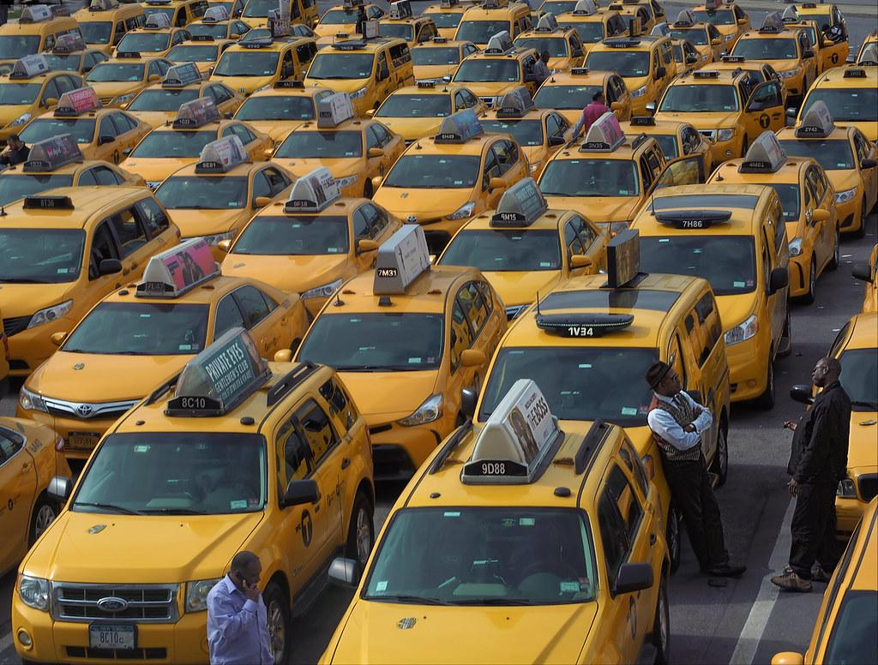
Cracking the Code
Building the Best Model for Predicting Hourly Taxi Arrivals
Group 1
Tolu
Alison
Jay

Slide 2
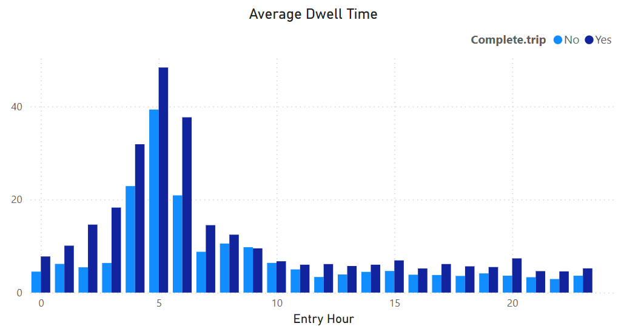
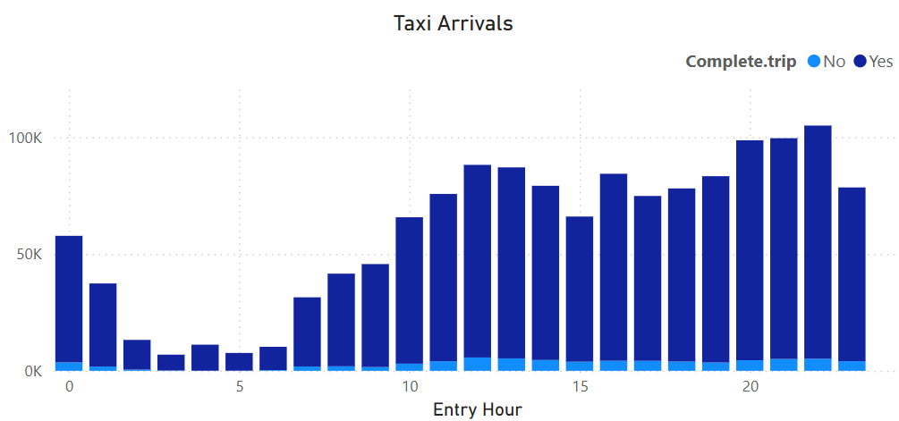
Data Preparation
Entry Hour | Arriving time
Hour | Hour of the day
Taxi Arrivals | How many taxi arrive per hour
Average Dwell Time | Average time taxis spend waiting at the airport per hour
Complete trip ratio | Ratio of trips completed in that hour
Average Monthly Trip | Average number of trips made monthly by taxis arriving in that hour
Day of Week | Day of the week
Lag1, Lag2 | Arrivals_t-1, Arrivals_t-2
Rolling 3 hour | ((Arrivals_t)+(Arrivals_t-1)+(Arrivals_t-2))/3
Notes:
RL_3hrs -Smooths out fluctuations and noise, Captures the overall trend or flow direction
Lag 1, 2 Gives the model short-term memory of recent demand, Useful to detect sudden spikes or drops
.shift() - to create lag 1,2
.rolling(3).mean() - It takes the average of the current and previous 2 rows — a 3-hour moving average.

Slide 3
Model Development:
We tried 6 models based on the independent variables:
Linear Regression
Linear regression with a logarithmic transformation
Linear regression with an exponential transformation
Poisson regression
XGBoost
Random forest
Notes:
We tried 6 models based on the variables
Linear regression
Linear regression on the logged and exponential value of the Hourly Taxi arrivals
Poisson regression
XGBoost
Random forest

Slide 4
Model Validation
Model | Mean Absolute Percentage Error | Root Mean Squared Error
Linear Regression | 414.1 | 41.5
Linear regression (w/ logarithmic transform) | 139.8 | 0.9
Linear regression (w/ exponential transform) | 7.3E+123 | 2.0E+131
Poisson | 182.0 | 37.0
XGBoost | 54.4 | 8.1
Random forest | 52.1 | 8.4
Notes:
Took the root mean squared error but ultimately chose to use the mean absolute percentage error as the deciding criteria to give a fair comparison between models and transformations
As you can see, the RMSE of the logged transformed regression is much lower than the original linear regression due to the lower logged taxi arrival values
Based on our criteria, the random forest model was the best, but notably the XGBoost model had the lowest RMSE

Slide 5
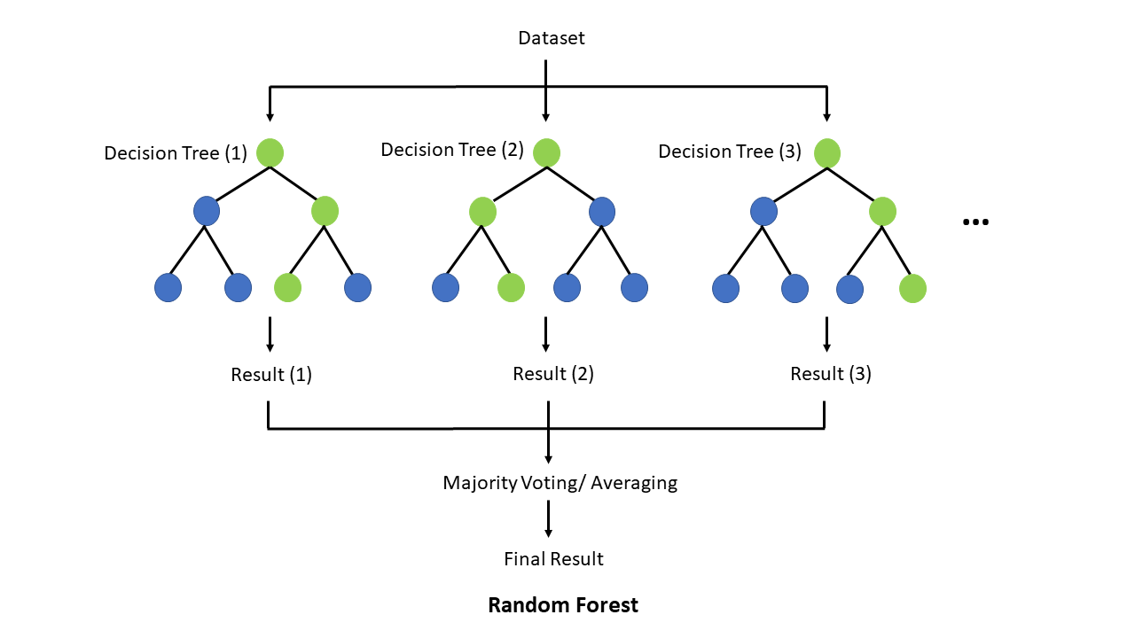
Random Forest
Notes:
averaging predictions from 100 trees.
A depth of 6 means : maximum number of splits (levels) a decision tree can have.
Random_state = 42 : make all the random choices consistent, the same trees are built in the same way, get the same results every time

Slide 6
Applicability vs Usefulness
The data is structured.
The relationship between inputs and taxi arrivals is non-linear (e.g., busy periods don't follow a straight line).
Helps airport authorities plan ahead for taxi stand congestion.
Provides hour-by-hour forecasts that could feed into real-time dashboards.

Slide 7
Strength vs Weakness
Handles non-linear patterns
Reduce overfitting
Individual outlier don’t throw off the model
Feature importance available
Sensitive to unbalanced or sparse data
Can't forecast far into the future without feature engineering.
It can't predict outside the range of training data.
Less interpretable.
Notes:
Overfitting- combining many trees and adding randomness, the tree doesn’t look at all features, only a random subset.
Sparse - Model may struggle to learn from or predict accurately in those cases

Slide 8
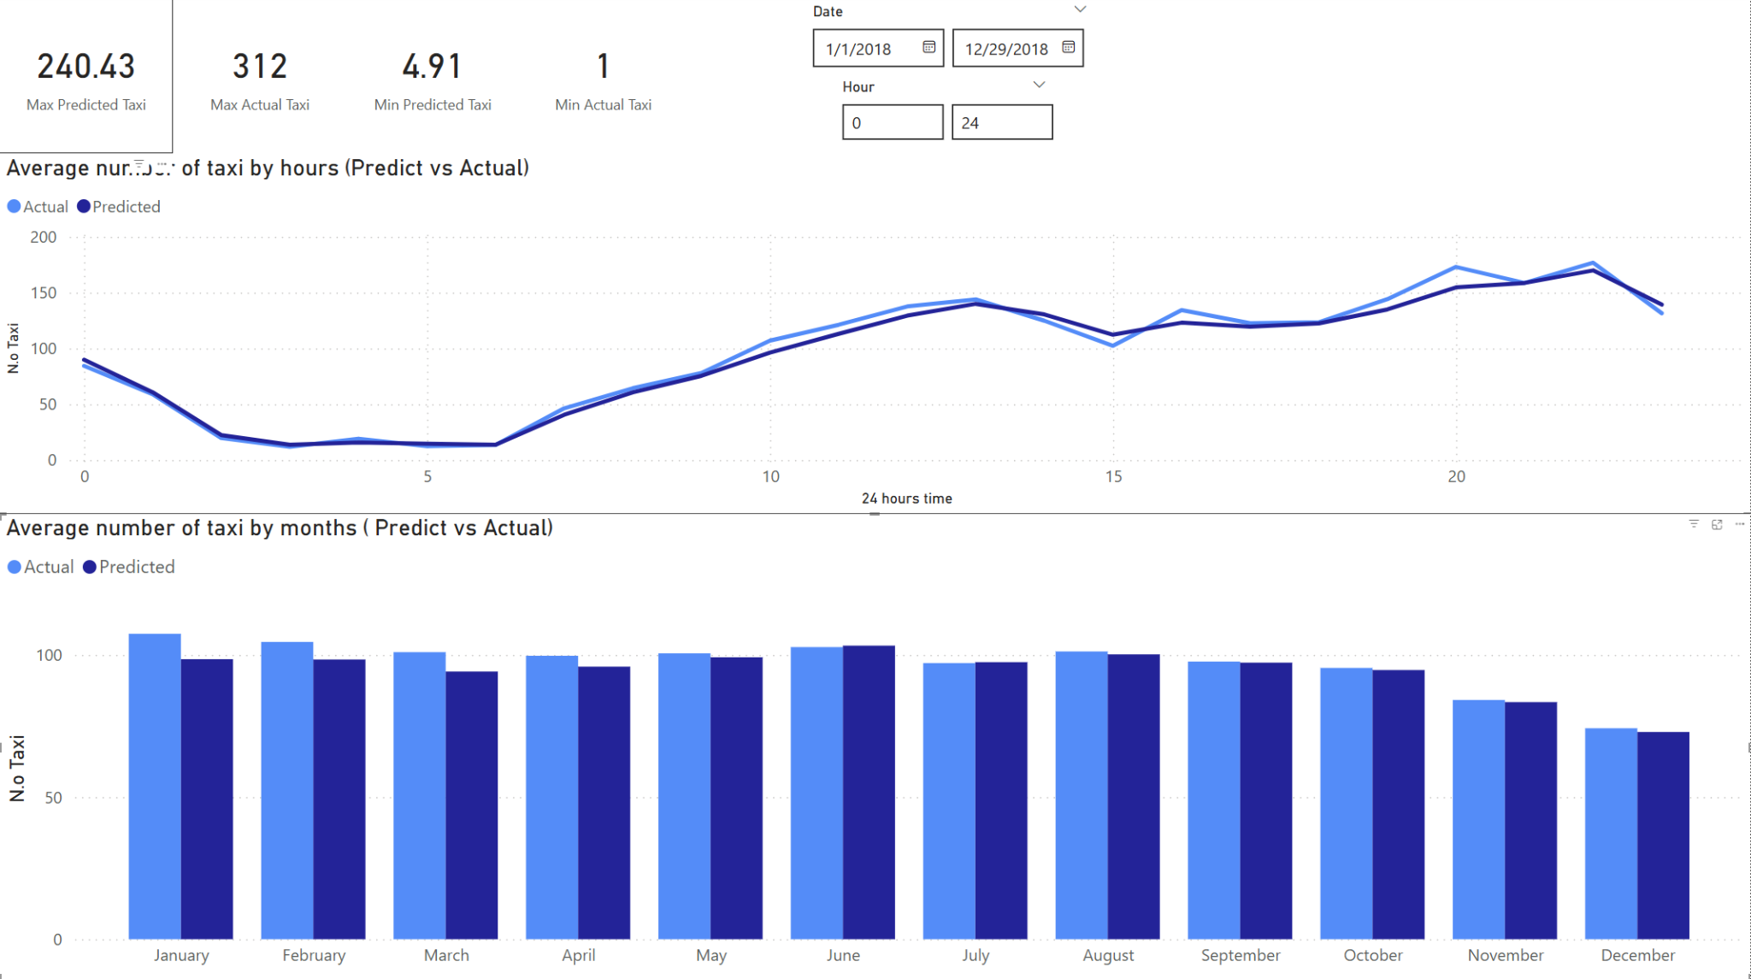

Slide 9
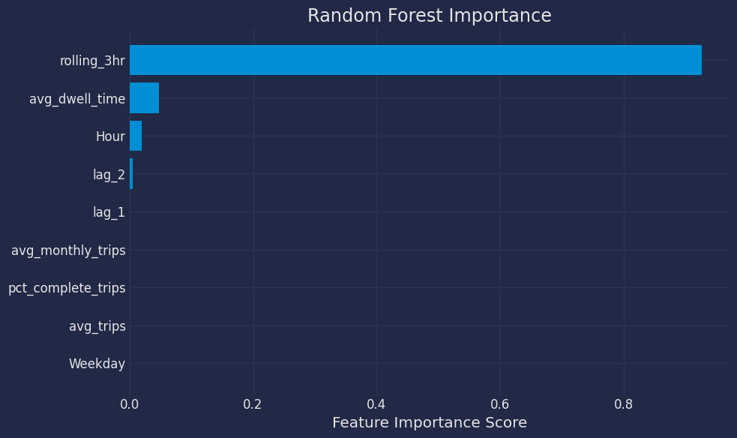
Notes:
Rolling 3 hours alone accounts for >80% of the model’s decisions.
Since 3-hour average of taxi arrivals is highly predictive of the next hour's demand.
It uses a metric like Mean Squared Error (MSE)
Each time a feature is used to split a node, it looks at how much that split reduces the error.
Adds up all the improvements that feature made across all trees
Normalizes those scores so the total importance = 1.0 (or 100%)

